Slide 1

Web Crawler and nlp system proof-of-concept
PUBLICATION AND SYSTEM LIMITATIONS
Nikki Fitzherbert
MA5851 Master Class 1

Slide 2
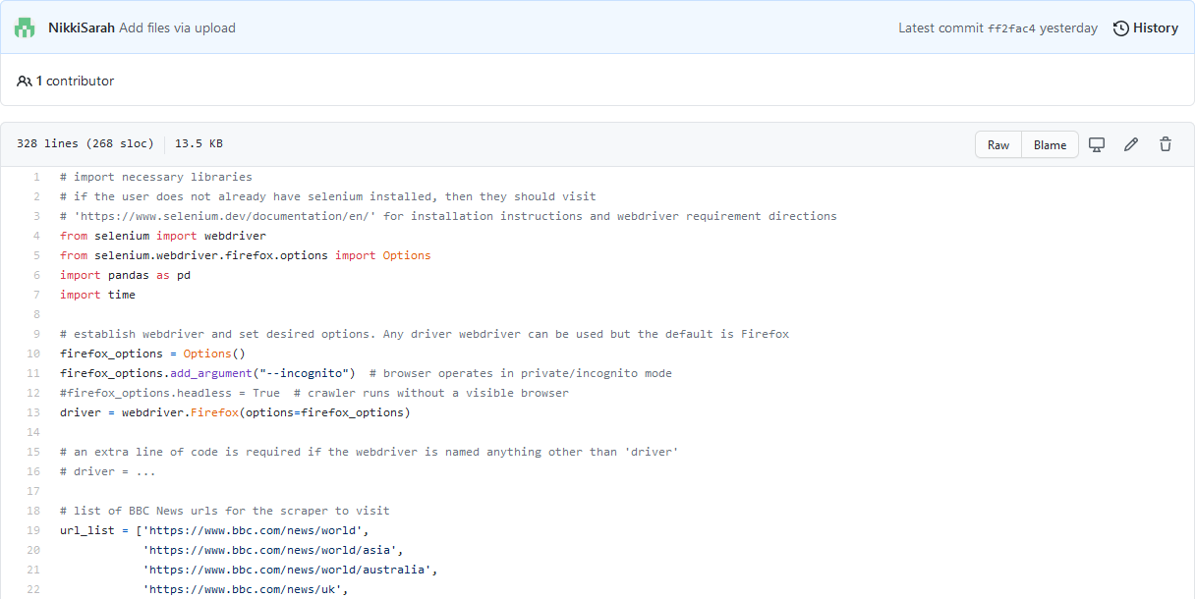
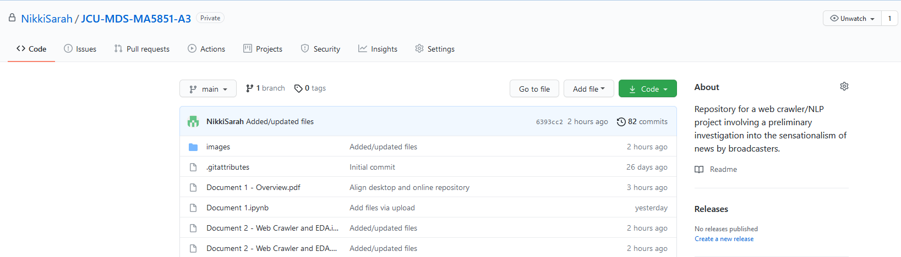
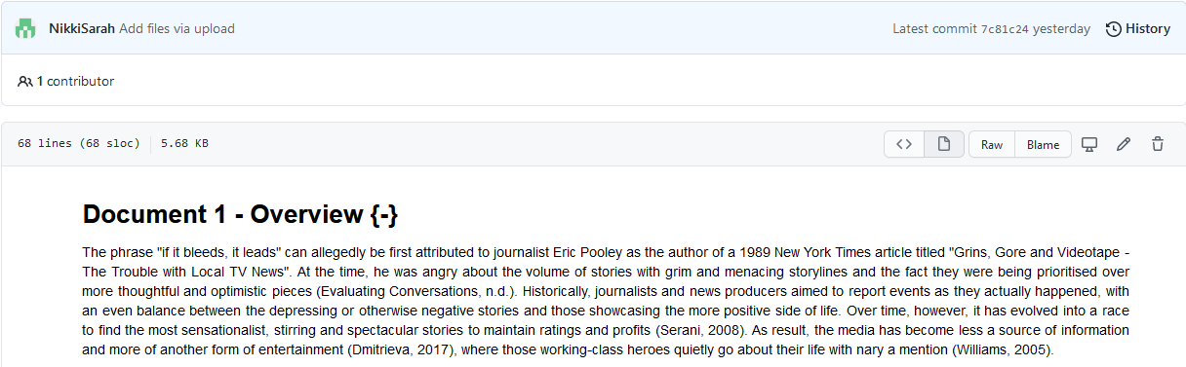
github repository

Slide 3
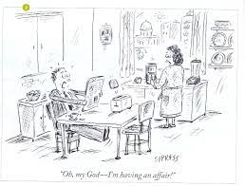
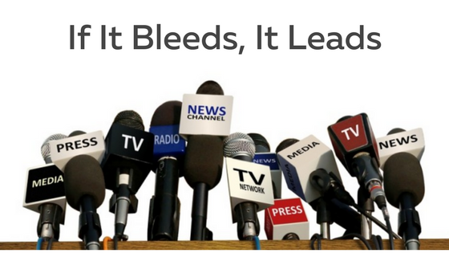
The problem

Slide 4
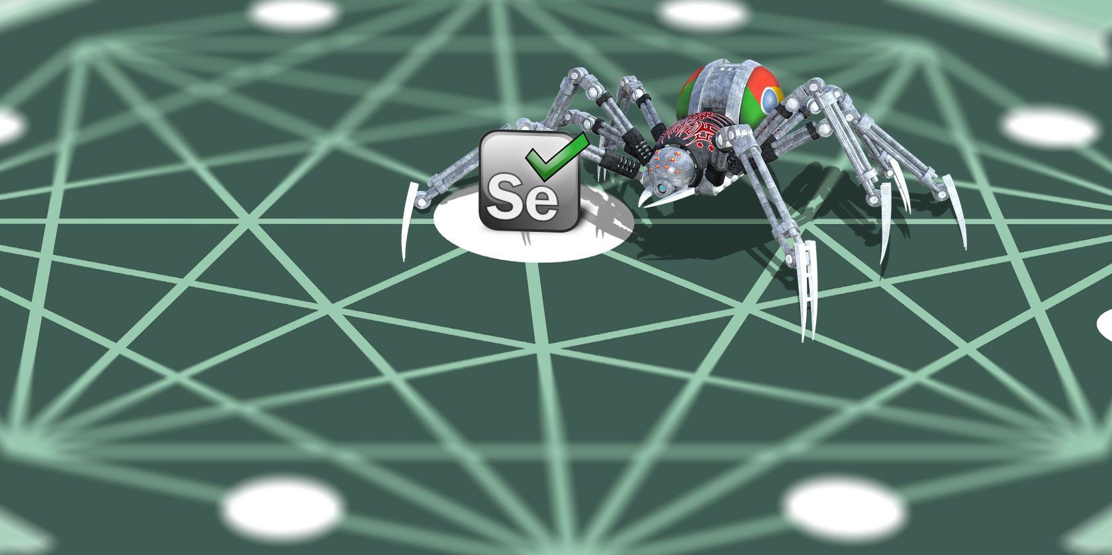
Web crawler limitations
Slow
Not entirely stable
Unable to handle advanced webpage elements

Slide 5
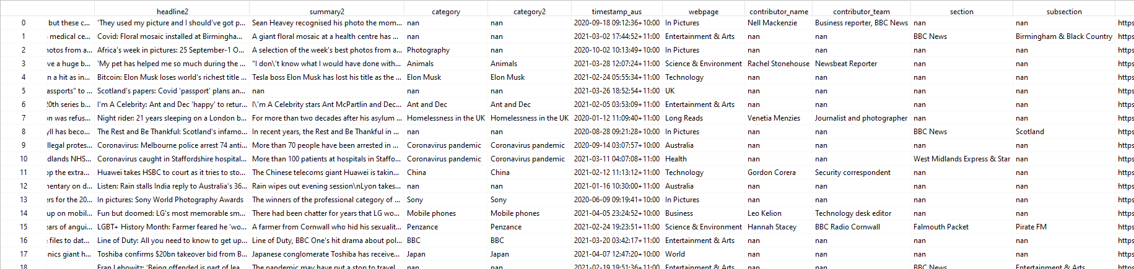
Harvested data limitations
Data sparseness
…

Slide 6
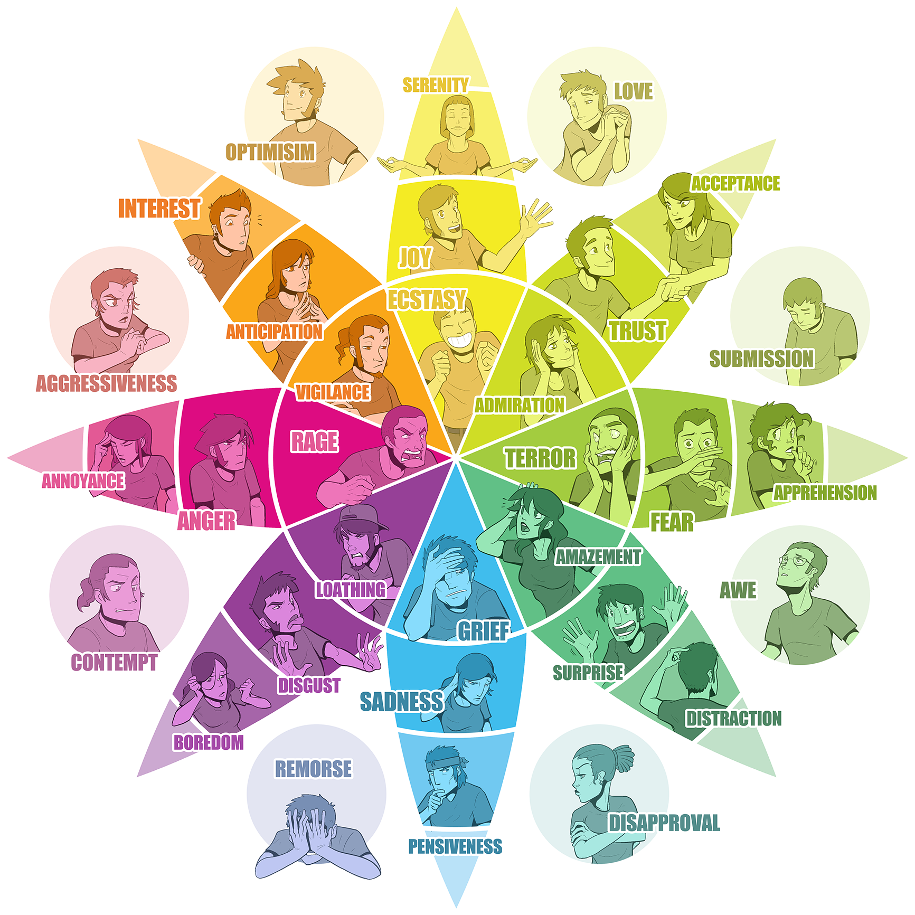
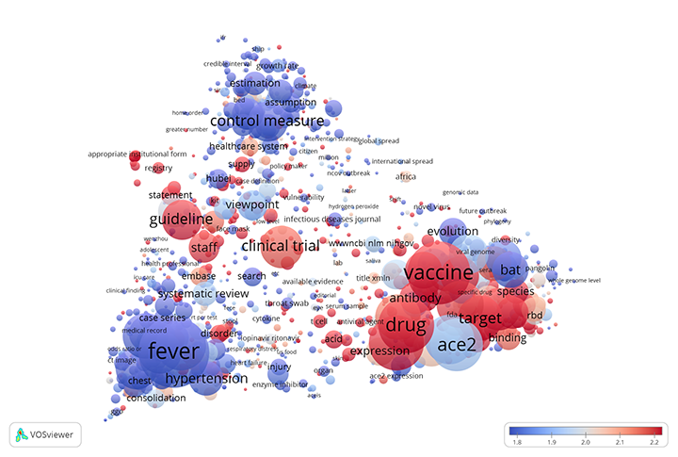
Nlp task limitations
SENTIMENT ANALYSIS
TOPIC MODELLING
Availability of a news-specific lexicon
NRC Emotion lexicon
Sentiment rating thresholds
Comparison to a machine-learning approach
Hyperparameter specification
NMF vs other models
Performance assessment

Slide 7
Questions?

